Slide 1
Management Information System (MIS) for Faculty of Agriculture, Rajarata University ”
Funded by AHEAD Project
Prof. K. P. Hewagamage
University of Colombo School of Computing

Slide 2
Outline
Objective of the Workshop
About MIS for Agriculture Faculty
Key Features/Facilities of MIS for the student
Demonstrations
Discussion of Q & A
Notes:
Your suggestions and issues will be considered seriously to carry out the programme

Slide 3
Objectives
Introduce the MIS developed for the Faculty of Agriculture, Rajarata University
Target audience - Students
Topics of MIS
Updating the Student Profile
Semester Registration
Applying Exams
Examination Results

Slide 4
What is MIS?
MIS - Management Information Systems
Computer based Systems
Provide required information for decision making
Users of MIS (Stakeholders)
Dean, Heads, Administrators, Academics, other non-academics, students
Designed and developed based on selected business activities of the organization
Web based Online System available 24hrs

Slide 5
Benefits of MIS
Better decision making
Increase productivity of organization
Effective Management
Reduced Paper work
Efficient Communication
Protect privacy and security

Slide 6
MIS for the Faculty of Agriculture
Scope of MIS
Registration of all undergraduate students with respect to academic years
Maintain the student profile and contact details
Management of students with respect to batches

Slide 7
MIS Scope …
Course Management with respect to regulation and academic departments
Administration of Exams including Admissions
Processing of Examination Results and Exam Boards
Publishing of Examination Results
Processing of Specialization
Produce academic certification for students and graduates

Slide 8
Policy and Regulation / MIS
Developed by the Faculty Board
Approved by the Senate/Council
Illegal Activities are prohibited
Unauthorized access of others information
Misuse of Username and password
Sabotage the system
Development : funded by the AHEAD Project of World Bank

Slide 9
How to access the MIS ?
MIS Student Portal
https://agrimis.rjt.ac.lk/
You should be registered student and you should know your registration number
Password is your NIC number
This could be changed if you want

Slide 10
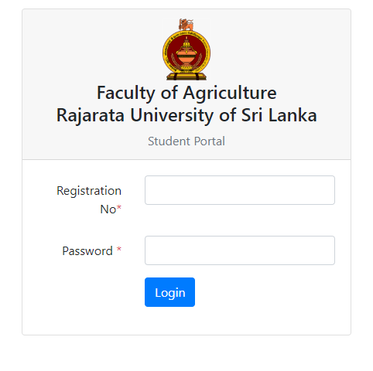
https://agrimis.rjt.ac.lk/

Slide 11
First Access of MIS
Please check your photo, name and other details
Contact AR/Exam division if details are wrong
Send an email to ar@agri.rjt.ac.lk. Pl.
subject as : MIS - AG/20XX/XXX BY <your Reg. No>
All students should update their important profile details

Slide 12
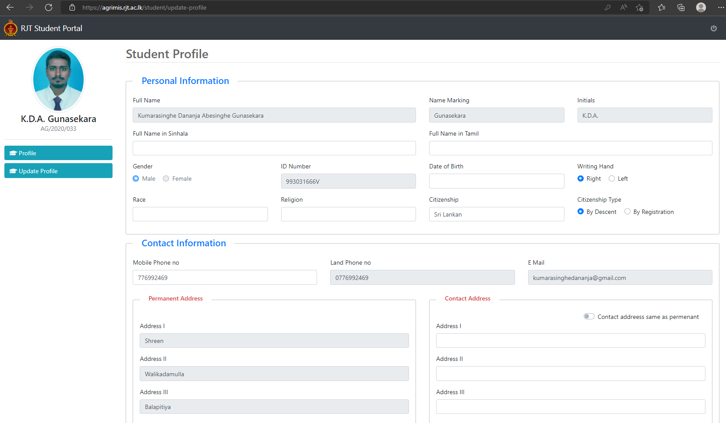

Slide 13
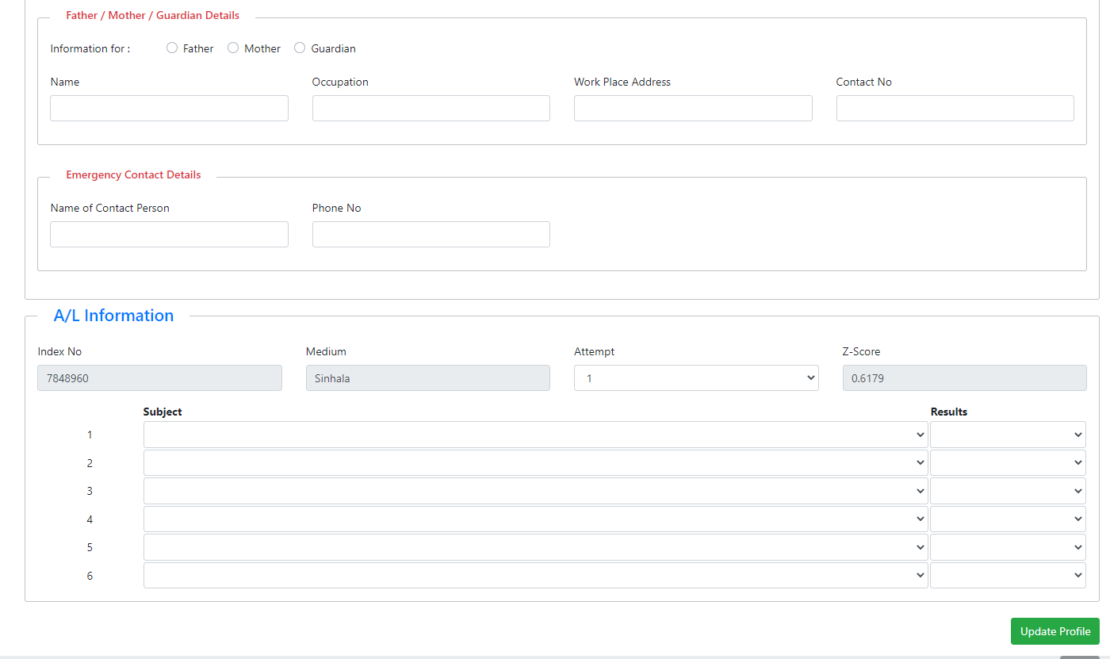

Slide 14
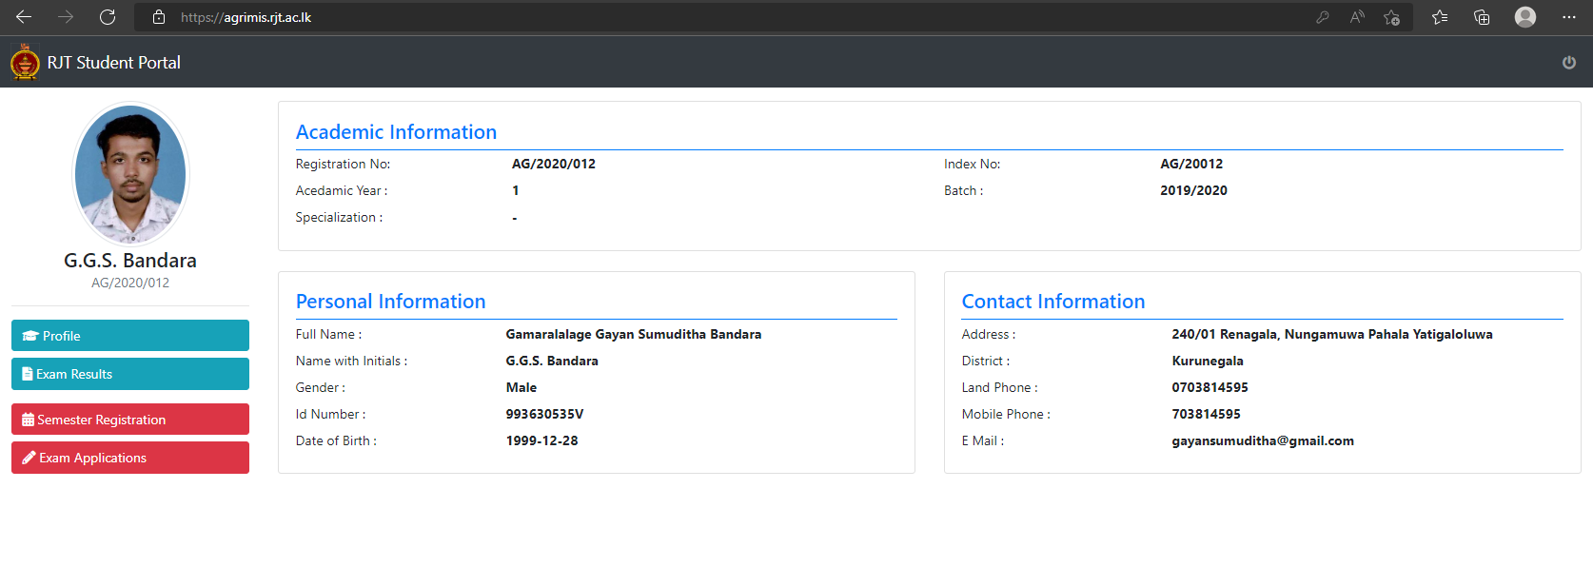
Once you completed the profile

Slide 15
Discussion
Q & A

